Slide 1
GLANDERS by Hussein Ali Naji

Slide 2
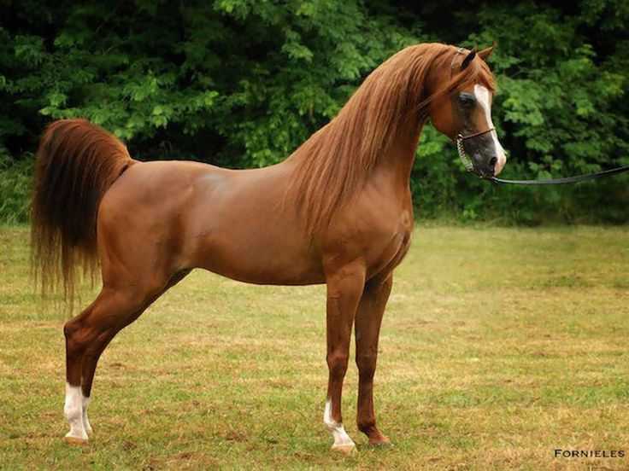

Slide 3
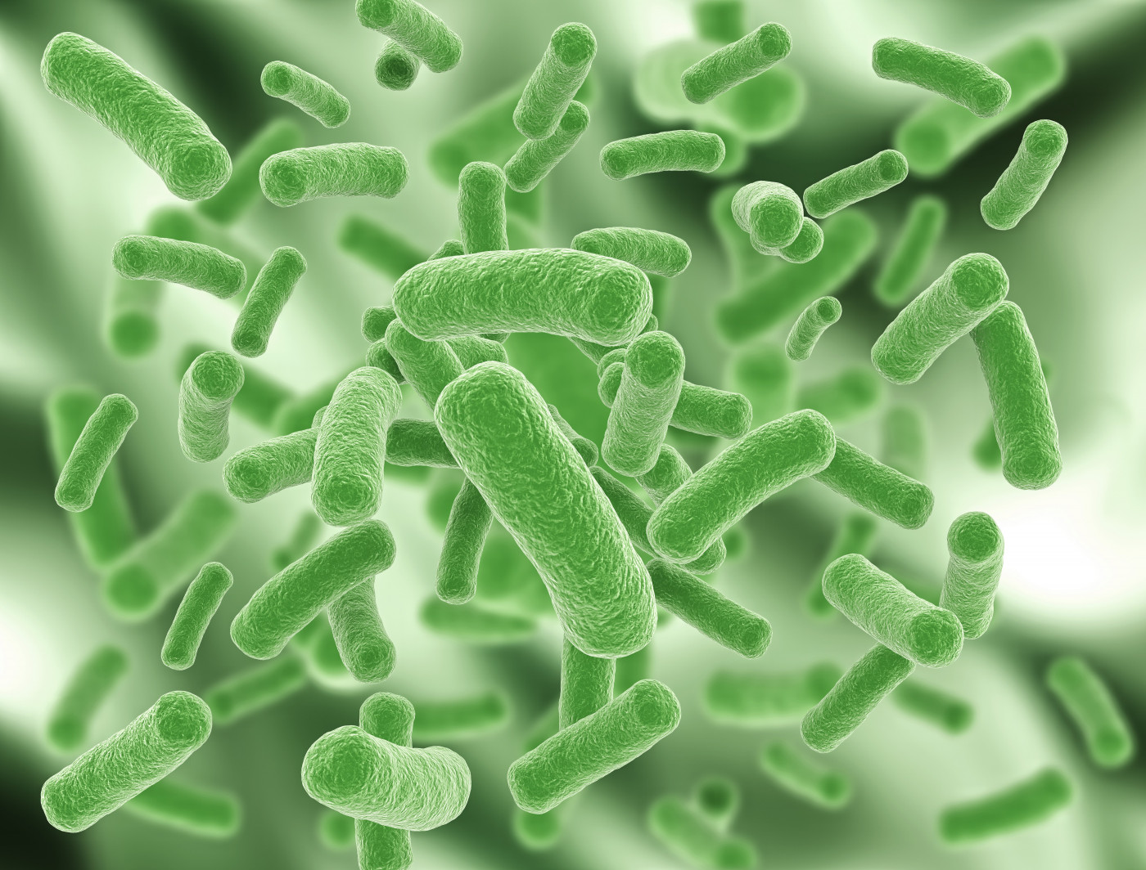
Etiology
Burkholderia (Pseudomonas) mallei is the causative organism. It is a Gram negative bacillus and predominantly exists in infected hosts, but may remain viable for several months in warm moist environments.

Slide 4
Host occurrence
Horses ( chronic form) , mules (acute and chronic form), and donkeys (acute form) are the species usually affected. Humans are susceptible and the infection is usually fatal. Carnivores, including lions may be infected by eating infected meat and infections have been observed in sheep and goats, cattle and pigs resistant .

Slide 5
Transmission
By diseased or latently infected animals.
Ingestion of the organism is the major route of infection.
Close contact between animals alone does not usually result in transmission, but transmission is facilitated if animals share feeding or watering facilities.
B. mallei is readily spread on fomites, including harnesses, grooming tools, and food and water troughs.
Carnivores usually become infected when they eat contaminated meat.

Slide 6
In Humane
1- The bacteria that cause glanders are transmitted to humans through contact with tissues or body fluids of infected animals.
2- The bacteria enter the body through cuts or abrasions in the skin and through mucosal surfaces such as the eyes and nose.
3- It may also be inhaled via infected aerosols or dust contaminated by infected animals. Sporadic cases have been documented in veterinarians, horse caretakers, and laboratorians.

Slide 7
Signs and Symptoms in Humane
Symptoms of glanders commonly include:
1- Fever with chills and sweating 2- Muscle aches 3- Chest pain
4- Muscle tightness 5- Headache 6- Nasal discharge
7- Light sensitivity (sometimes with excessive tearing of the eyes)
It is vary depending on the type of infection. The four types of infections, along with the symptoms associated with each, are listed below.
A- Localized Infection
If there is a cut or scratch in the skin, a localized infection with ulceration may develop within 1 to 5 days at the site where the bacteria entered the body. Swollen lymph nodes may also be apparent.

Slide 8
2- Pulmonary Infection
Glanders often manifests itself as pulmonary infection. In pulmonary infections, pneumonia, pulmonary abscesses, and pleural effusion can occur. Chest X-rays will show localized infection in the lobes of the lungs.
3- Bloodstream Infection
Without treatment, glanders bloodstream infections are usually fatal within 7 to 10 days.
4- Chronic Infection
The chronic form of glanders involves multiple abscesses within the muscles and skin of the arms and legs or in the lungs, spleen, and/or liver.

Slide 9
CLI NICAL PATHOLOGY
Disease is accompanied by a low hemoglobin content of the blood, a low erythrocyte count and packed cell volume, and a moderate leukocytosis and neutrophilia.
Mallein test .The principal tests used in the diagnosis of glanders are the mallein test. The intradermopalpebral test has largely displaced the ophthalmic and SC tests. Mallein (0. 1 mL) is injected intradermally into the lower eyelid with a tuberculin syringe. The test is read at 48 h, a positive reaction comprising marked edema of the lid with blepharospasm and a severe, purulent conjunctivitis.

Slide 10
Serological tests include complement fixation test and Elisa.
Demonstration of organism If pus is available, from either open ulcers or necropsy material, the organism can be cultured or the pus injected intraperitoneally into male guinea pigs to attempt to elicit the Strauss reaction. This is a severe orchitis and inflammation of the scrotal sac but it is not highly specific for B. mallei. Gene sequencing can be used for rapid identification and differentiation from B. pseudomallei.

Slide 11
Treatment
Since human cases of glanders are rare, there is limited information about antibiotic treatment in humans. Sulfadiazine has been found to be effective in experimental animals and in humans.
In addition, the bacterium that causes glanders is usually susceptible to:
Tetracyclines, Ciprofloxacin, Streptomycin, Gentamicin, Ceftazidime, Sulfonamide

Slide 12
Prevention
In Horses Early detection and quarantine with Disinfection.
Test and slaughter.
Reportable to state veterinarian
Vaccine not available for humans or animals.
No specific treatment

Slide 13
T h a n k y o u

